Slide 1
Developing and Testing a High-Resolution Ensemble-Based 6-10 Day Forecast System for Atmospheric Rivers and Heavy Precipitation over the Western U.S.
Nick Weber, Greg Hakim and Cliff Mass
University of Washington

Slide 2
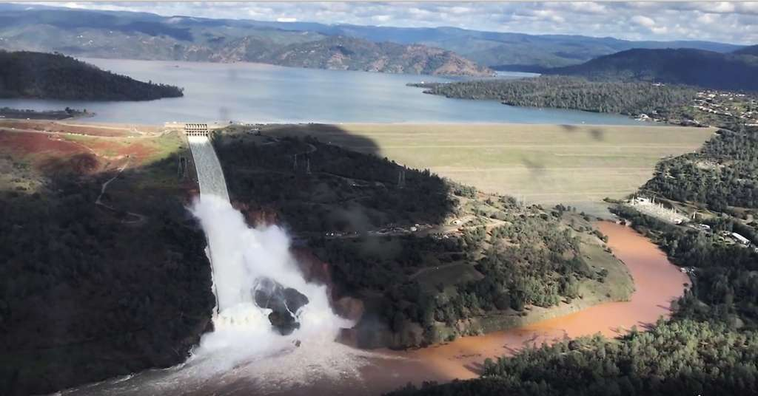
Improving 1-2 Week Forecasts Over the Western U.S. with an Emphasis on Atmospheric Rivers
Atmospheric rivers represent the most impactful weather feature of the western U.S.
Associated with flooding, loss of life, and dam/reservoir safety.
Skill in the second week can be important, since it provides guidance for reservoir draw downs during multiple atmospheric river events

Slide 3
Skill in Second Week Declines Rapidly (GEFS 500 hPa)
7-14 days

Slide 4
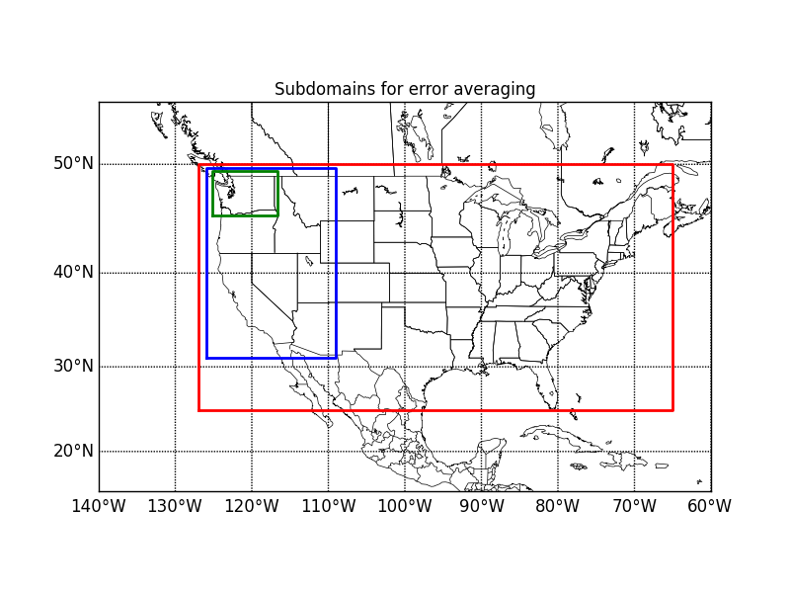
Looking at CFSv2 over the Western U.S.

Slide 5
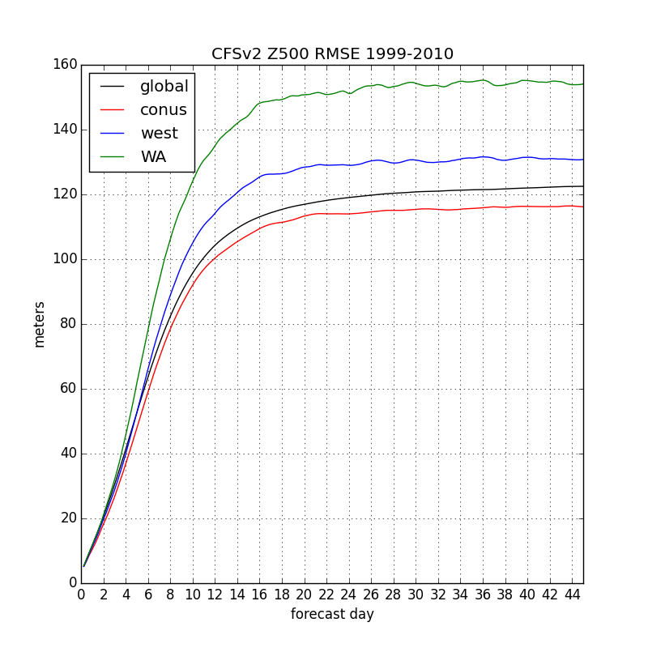
Rapid Increase in RMSE During Second Week

Slide 6
Work Presented Last Year Suggests that GFS/CFS Fails to Properly Simulate Mesoscale Convection in the Tropics May Be a Key Problem

Slide 7
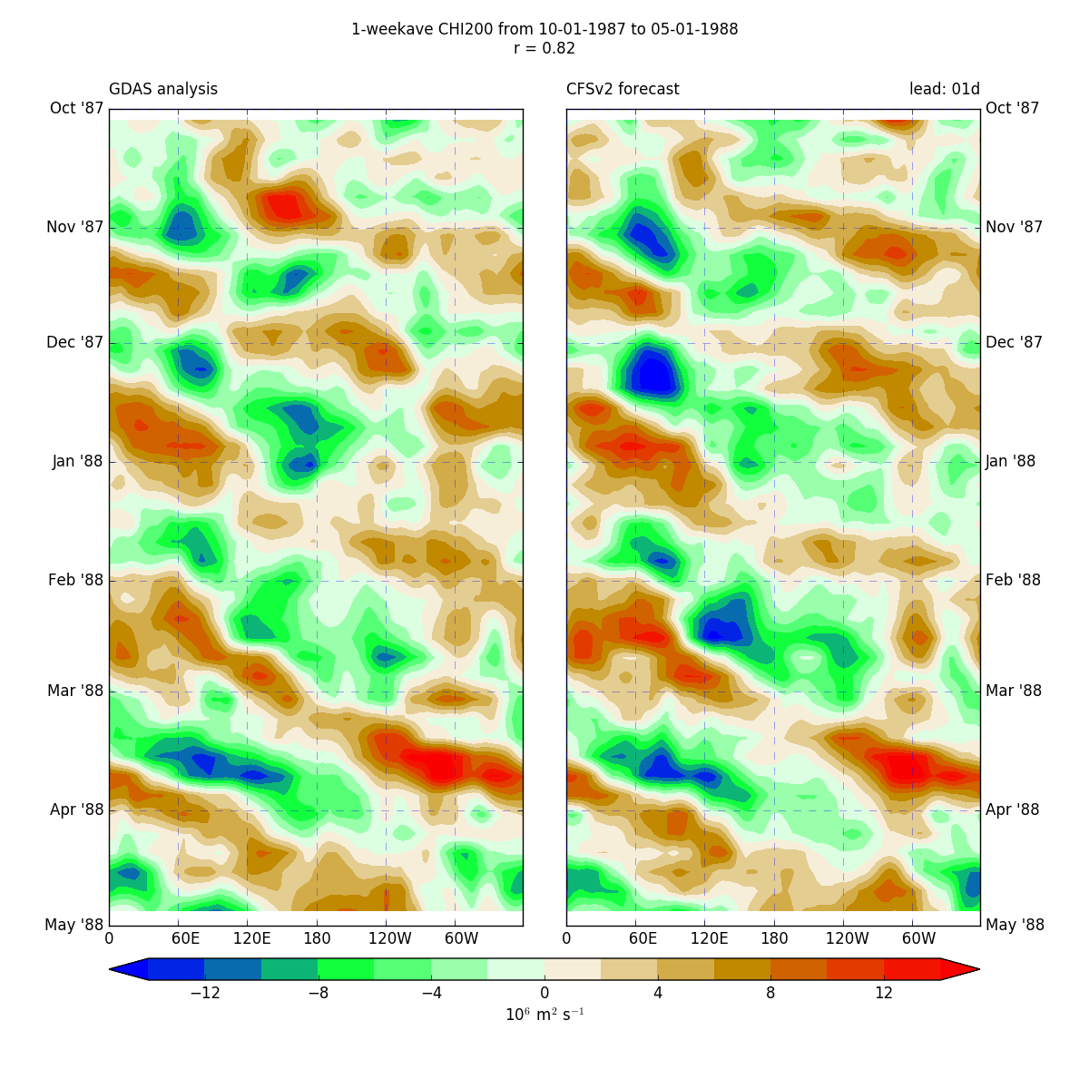
CHI200 Hovmoller: analysis vs week-1 CFS forecasts
Winter/Spring ‘87-’88
*single-member forecasts

Slide 8
CHI200 Hovmoller: analysis vs week-1 forecasts
Wave propagation in both analyses and forecasts
*single-member forecasts

Slide 9
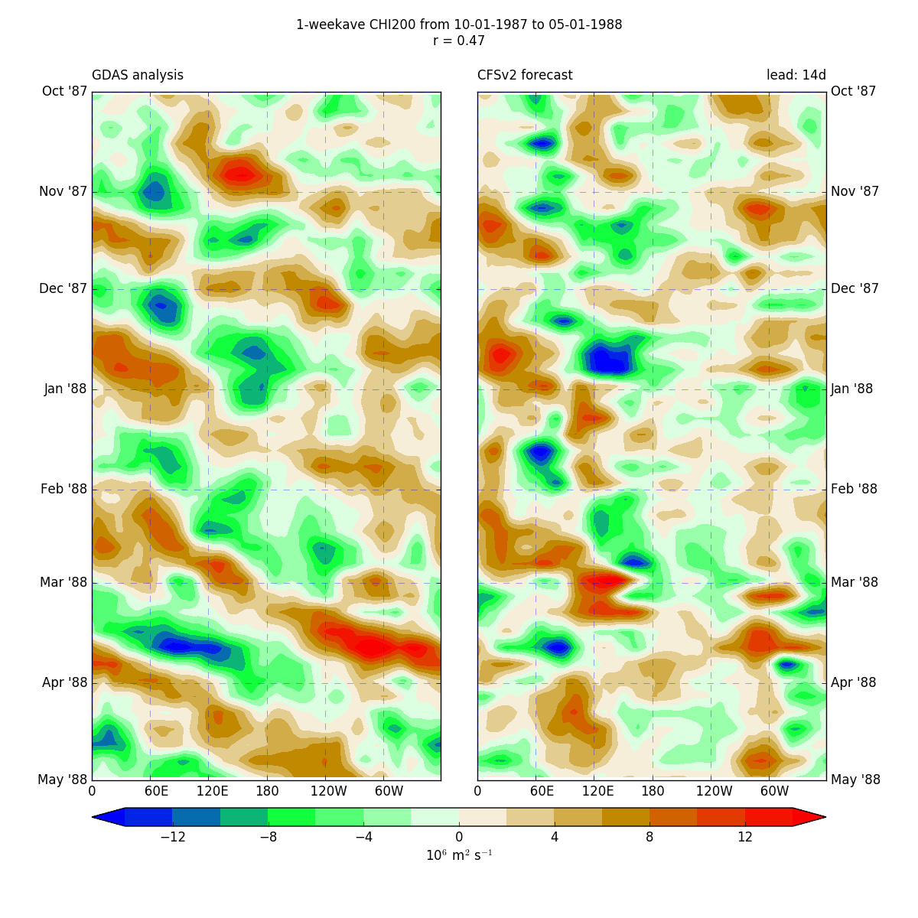
CHI200 Hovmoller: analysis vs week-3 forecasts
*single-member forecasts

Slide 10
So what can the NWS do to improve week 2 forecasts in support of atmospheric river and other forecasts?
Slow evolution/improvement: better dynamic core (e.g., FV-3), physics, and data assimilation.
Push to a jump to convection-allowing resolution in the tropics
Try conventional post-processing approaches (e.g., bias correction, Bayesian Model Averaging)
Try innovative post-processing approaches, such as Ensemble Forecast Adjustment

Slide 11
The UW Under NWS Support is Working on Two of These
Push to a jump to convection-allowing resolution in the tropics
Currently working on month-long runs at 3-km grid spacing over the tropics and globe with the MPAS model. Later FV-3.
Try innovative post-processing approaches, such as Ensemble Forecast Adjustment
This presentation!

Slide 12
Ensemble Forecast Adjustment EFA
Can we correct for some of GEFS deficiencies in week 2 statistically using ensemble temporal correlations?

Slide 13
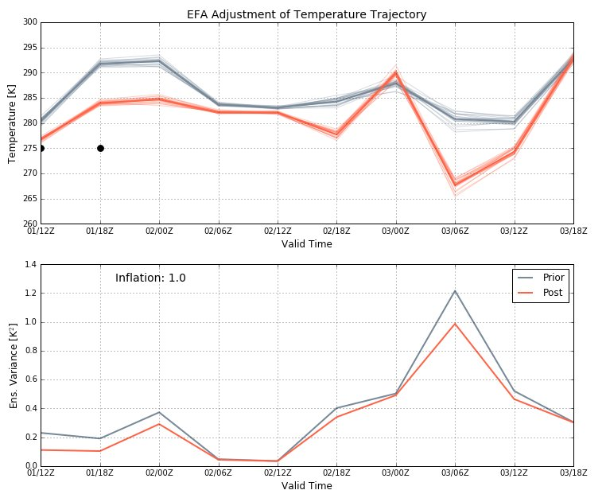
What is EFA?
Ensemble forecast adjustment: An offline data assimilation technique that uses temporal covariances in addition to spatial covariances to adjust the entire forecast using observations at one time (or several times) AFTER the forecasts are started.
obs

Slide 14
Can use temporal correlations for either averaged or non-averaged fields.
Initial dataset: The operational CFSv2 forecasts
- 16 members per day (rather than the 4 in the reforecast)
- specifically, the forecasts from DJF 2015-2016

Slide 15
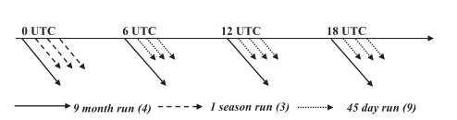
EFA dataset
Forecasts used:
CFSv2 operational forecasts from DJF 2015-2016.
Initialized 4x daily with 4 ensemble members
16 members per day
Lagged ensembles are assembled with members from the previous days’ forecasts
e.g., a 48-member ensemble contains members from the past 3 days
Verification:
GDAS analyses

Slide 16
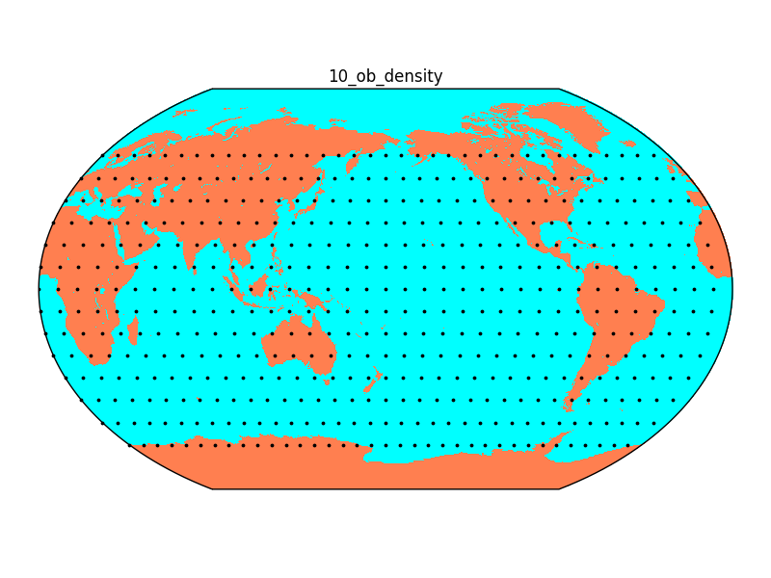
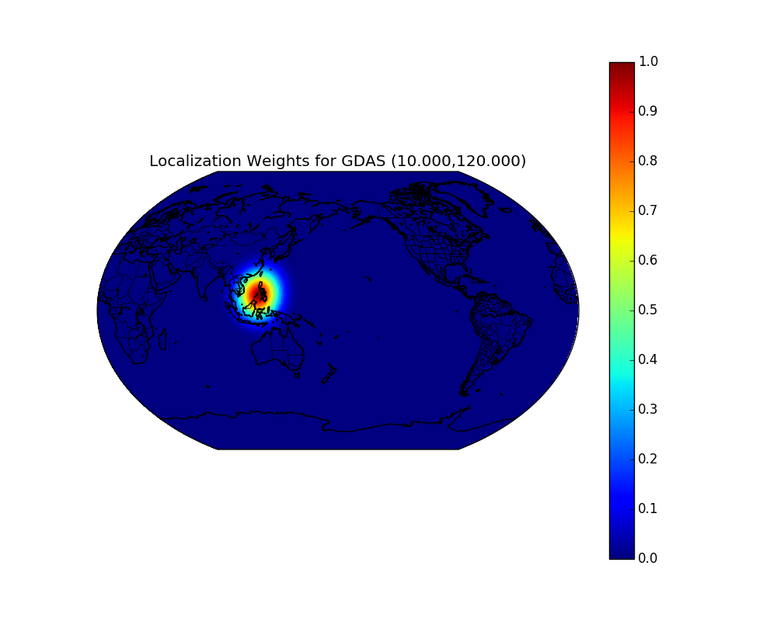
EFA: first experiment
Adjusted a single, 21-day, un-averaged CFSv2 forecast
different lagged ensemble sizes
Used GDAS analysis as “observations” by sampling every 10 grid points
Assimilated observations at initialization time:
December 01, 2015 00:00Z
Evaluated forecasts of Z500 and CHI200
Used Gaspari-Cohn spatial localization with a 2000 km half-width
No temporal localization
“Observational” error:
Z500: 10 m
CHI200: 0.1 m²s⁻¹

Slide 17
Can Ensemble’s Be Used to Improve 6-10 Day Forecasts?
The Proposed Approach: Ensemble Forecast Adjustment
EFA is an offline data assimilation technique that utilizes spatial and temporal ensemble covariances to improve a forecast by ingesting additional observations

Slide 18
EFA Approach
Start with an extended ensemble of forecasts
Such an ensemble allows both spatial and temporal covariances.
One can use such covariances to correct future forecasts based on the differences of the ensemble members with a short-term observation.

Slide 19
EFA Improvements for Short Term Forecasts (24-30 h

Slide 20
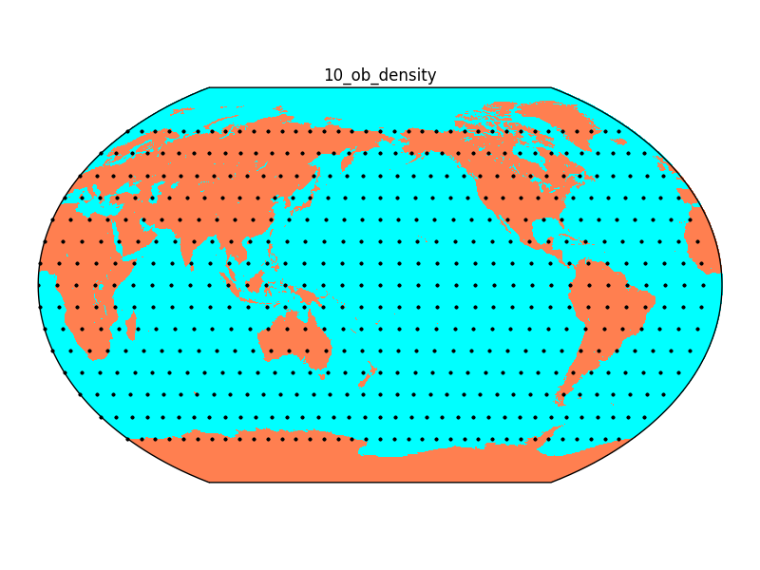
Data and Methods
Made use of an ensemble of CFSv2 forecasts
CFSv2 operational configuration: 16 daily members, can create larger ensembles by lagging
Verification: CFS Reanalysis (CFSR)
Our “obs” for assimilation are a spatial sampling of CFSR
Many “knobs” can be turned in the assimilation process
Ensemble size, localization, ob error variance, ob assimilation order, temporal averaging of the forecasts/obs, prior inflation, ob sampling density, ob assimilation times, using historical covariances vs ensemble covariances, etc…..

Slide 21
Initial Results Starting With Synoptic Fields

Slide 22
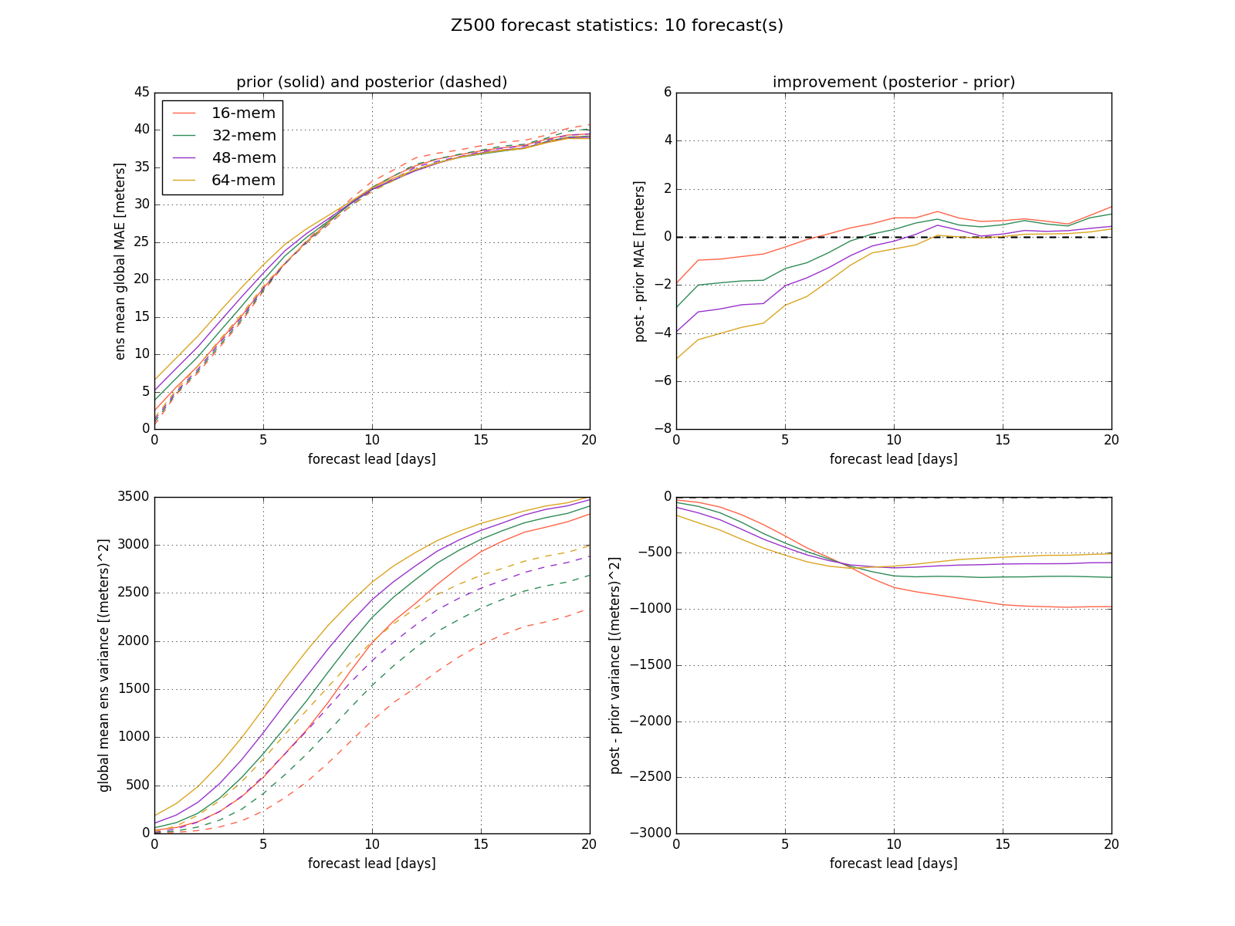
Improving global daily Z500 forecasts with EFA
EFA improves the daily-avg forecasts through day 6-12
Larger ensembles produce greater benefit
This is because EFA serves largely to erase the errors of the initial state, which are larger for lagged ensembles

Slide 23
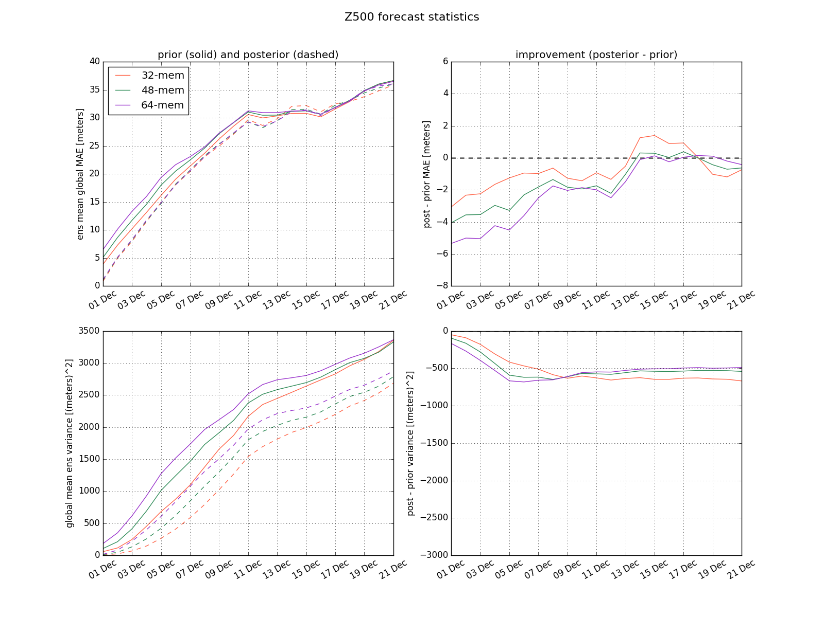
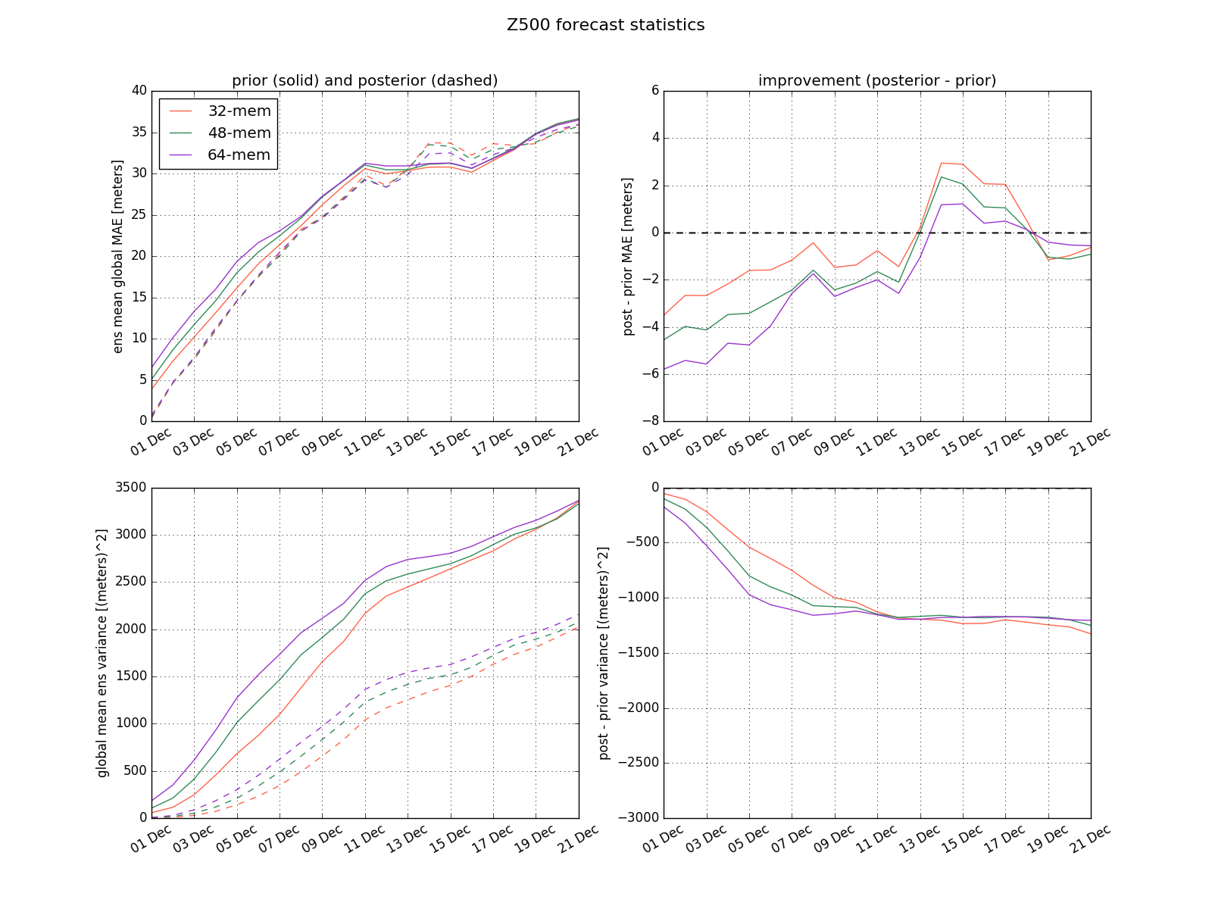
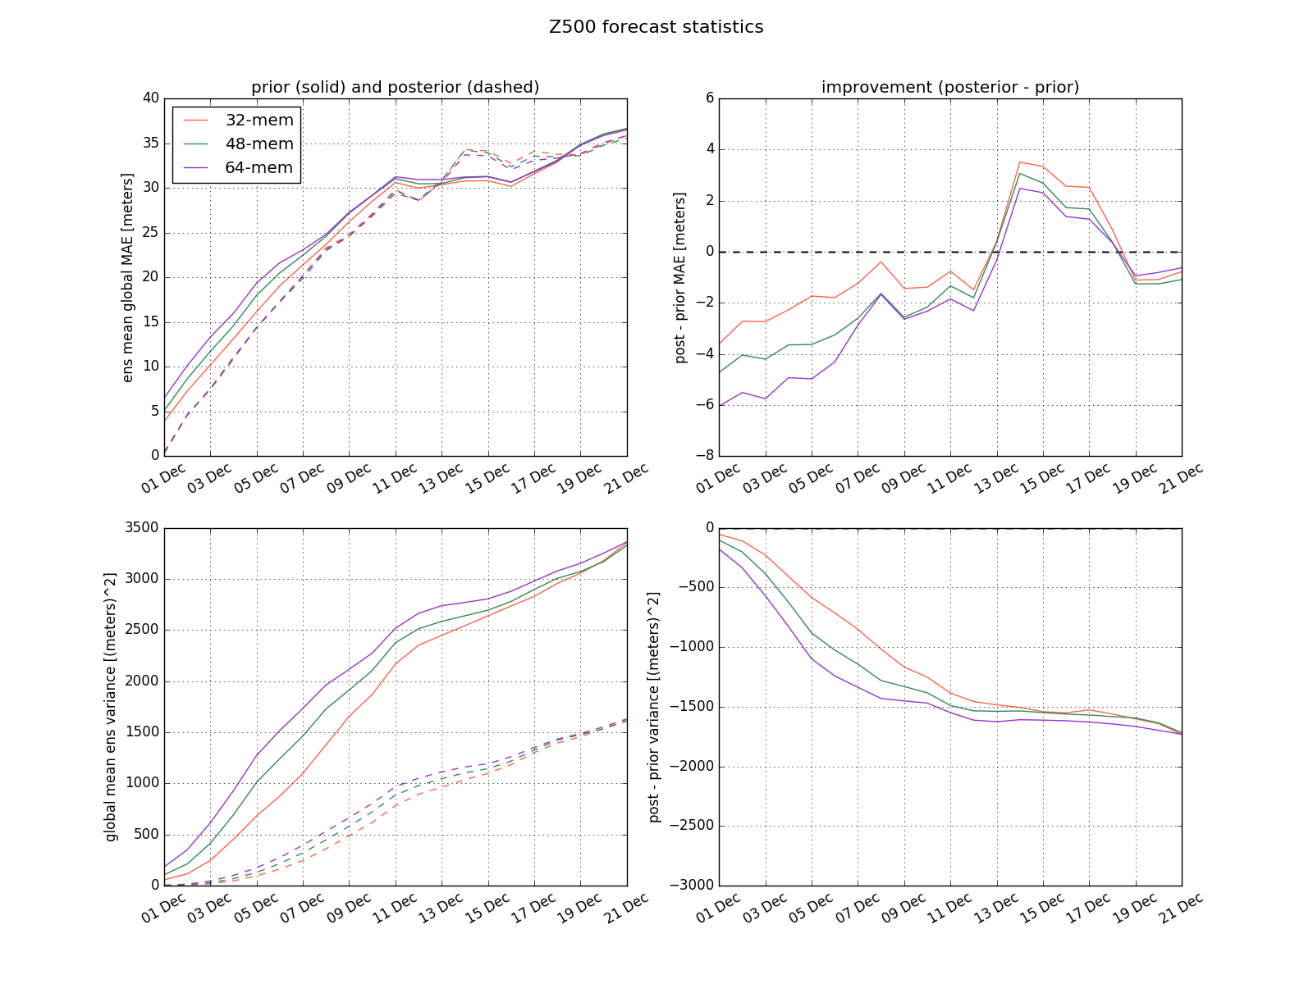
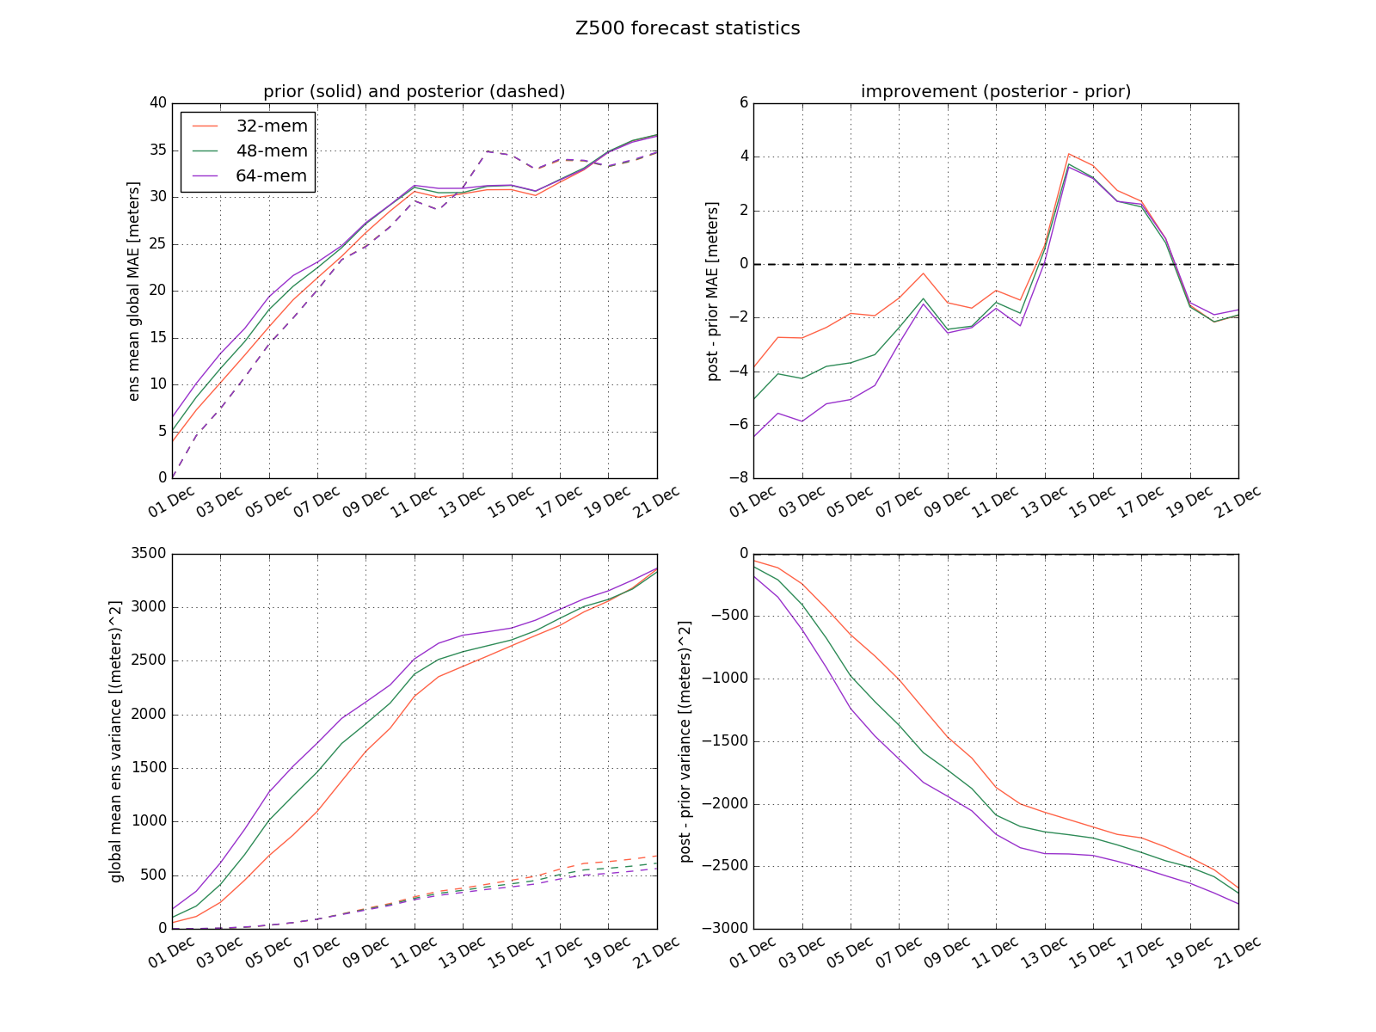
Sensitivity to localization radius -- Gaspari-Cohn
Larger localization radius → more improvements to the initial state, but further reduction of the variance at longer lead times, leading to a decline in skill
GC2000
GC4000
GC6000
No localization
Error
Spread

Slide 24
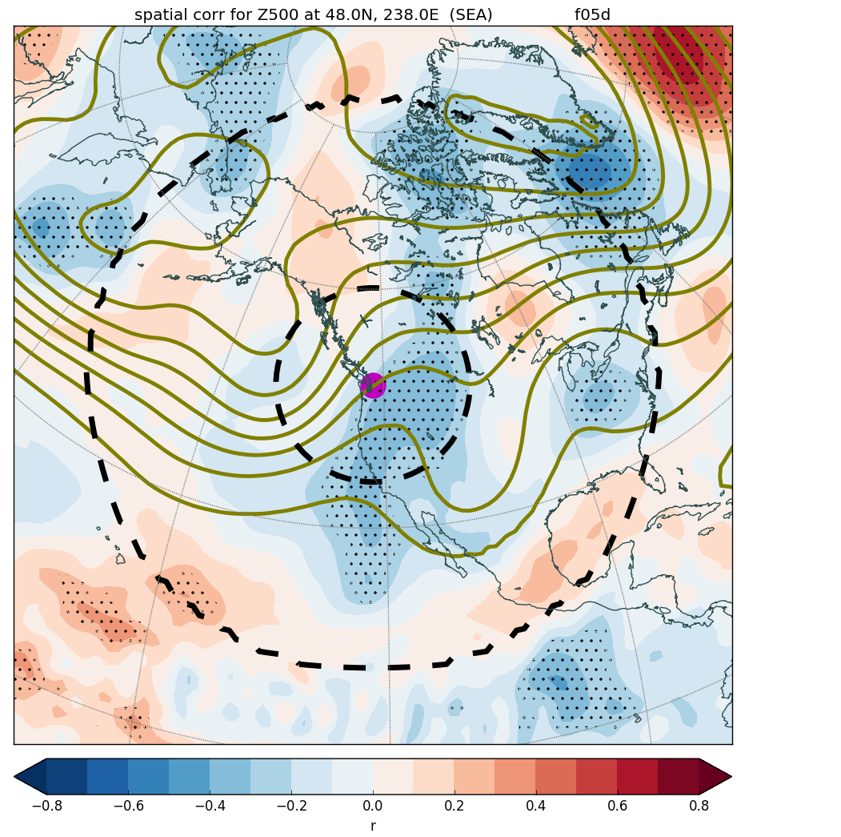
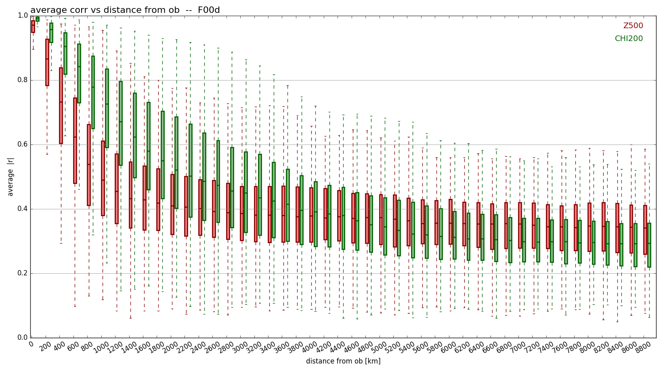
Significance-based localization
The ensemble estimate of Seattle Z500 is significantly correlated to estimates outside the Gaspari-Cohn localization range.
Potentially losing valuable information by not updating those points.

Slide 25
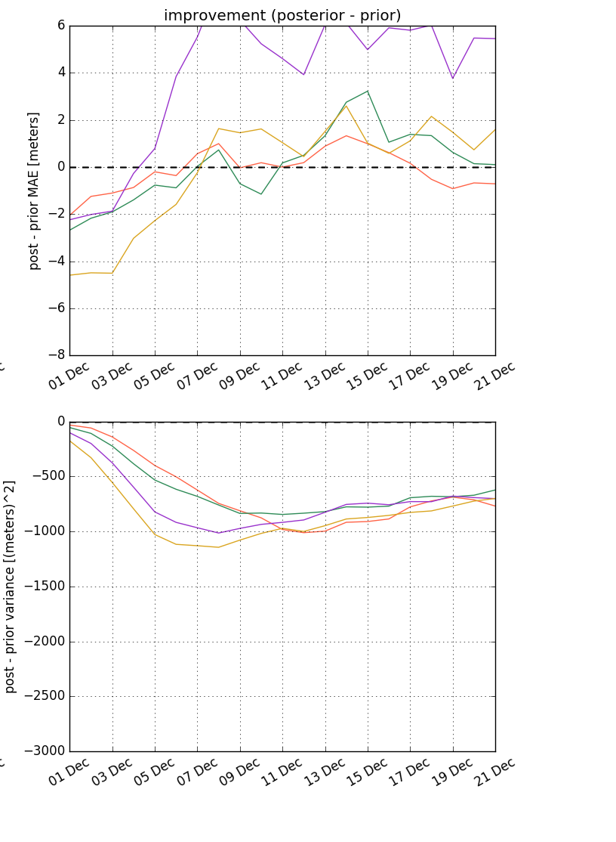
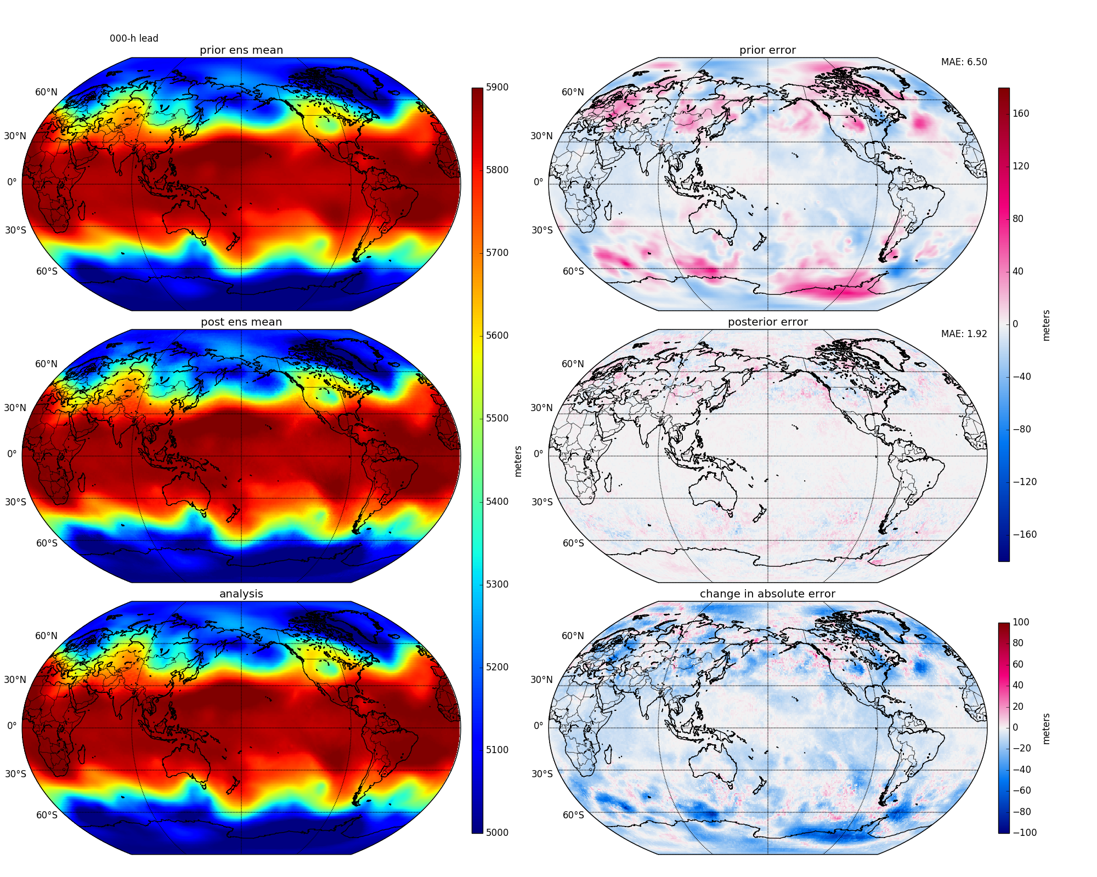
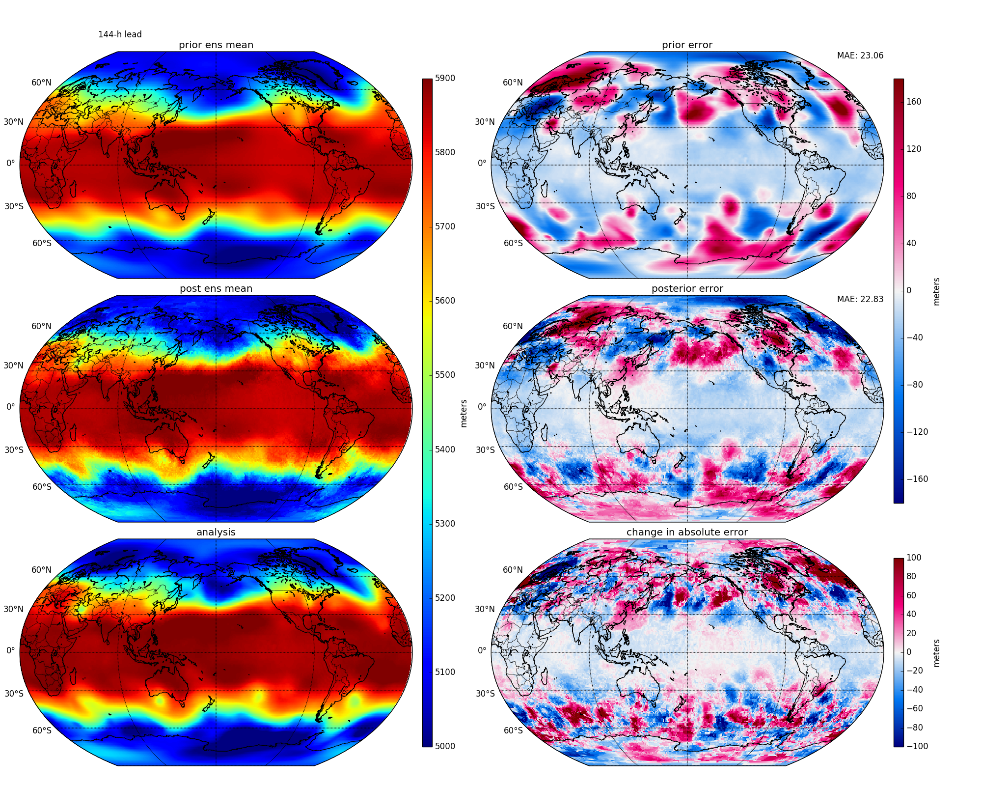
Significance-based localization
Not particularly promising thus far
Actually does worse with the larger 64-mem ensemble (purple)
The binary (1,0) weights create unphysical Z500 distributions after assimilation
Day - 1
Day - 6

Slide 26
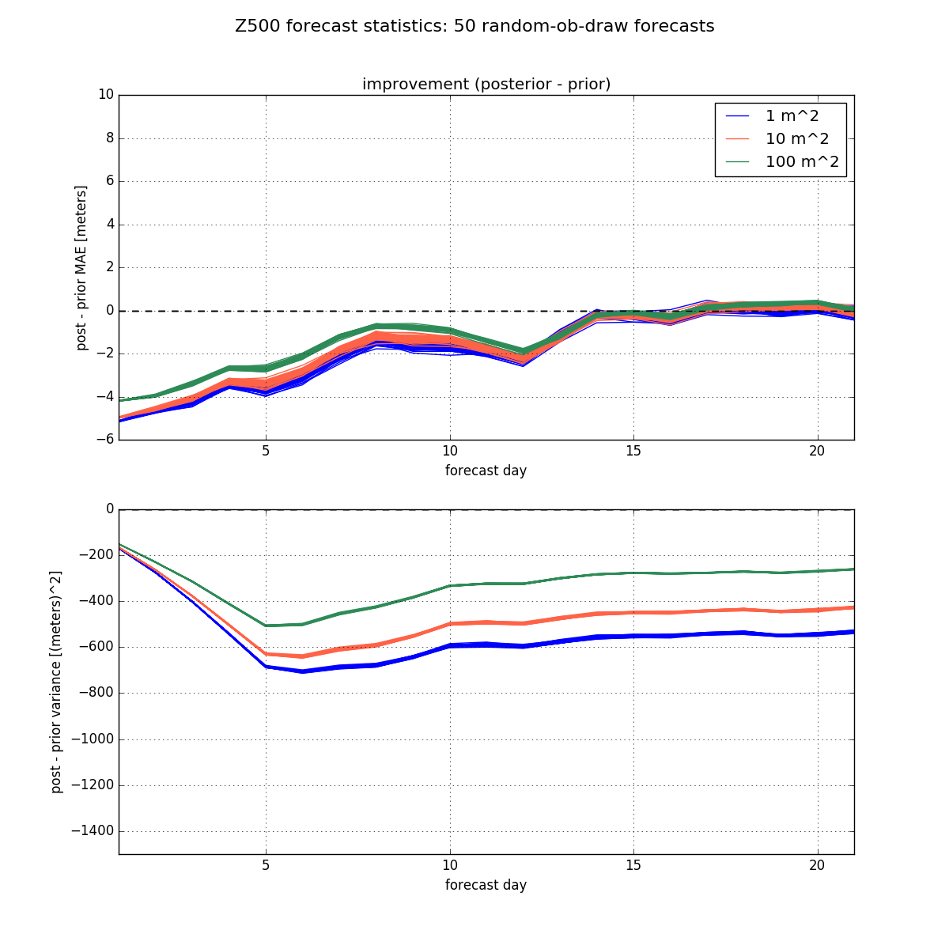
Sensitivity to observation error variance
Increasing the “observation” error variance slightly reduces the forecast improvement at shorter leads, but reduces the declineof ensemble spread
* Monte-Carlo experiments (obs assimilated in random order each time)

Slide 27
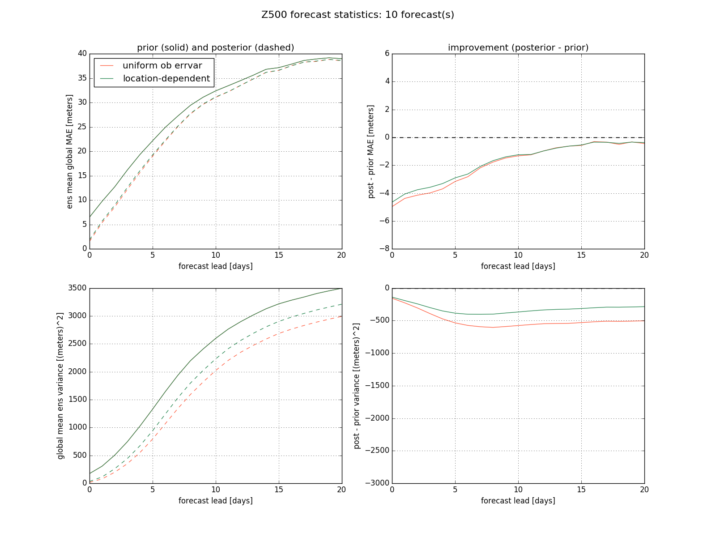
Using observation error variance
Location-dependent observation error variance: 42h fcst - 36h fcst using reforecasts (a measure of internal variability)
No significant impact skill improvement
Bolsters variance at longer lead times

Slide 28
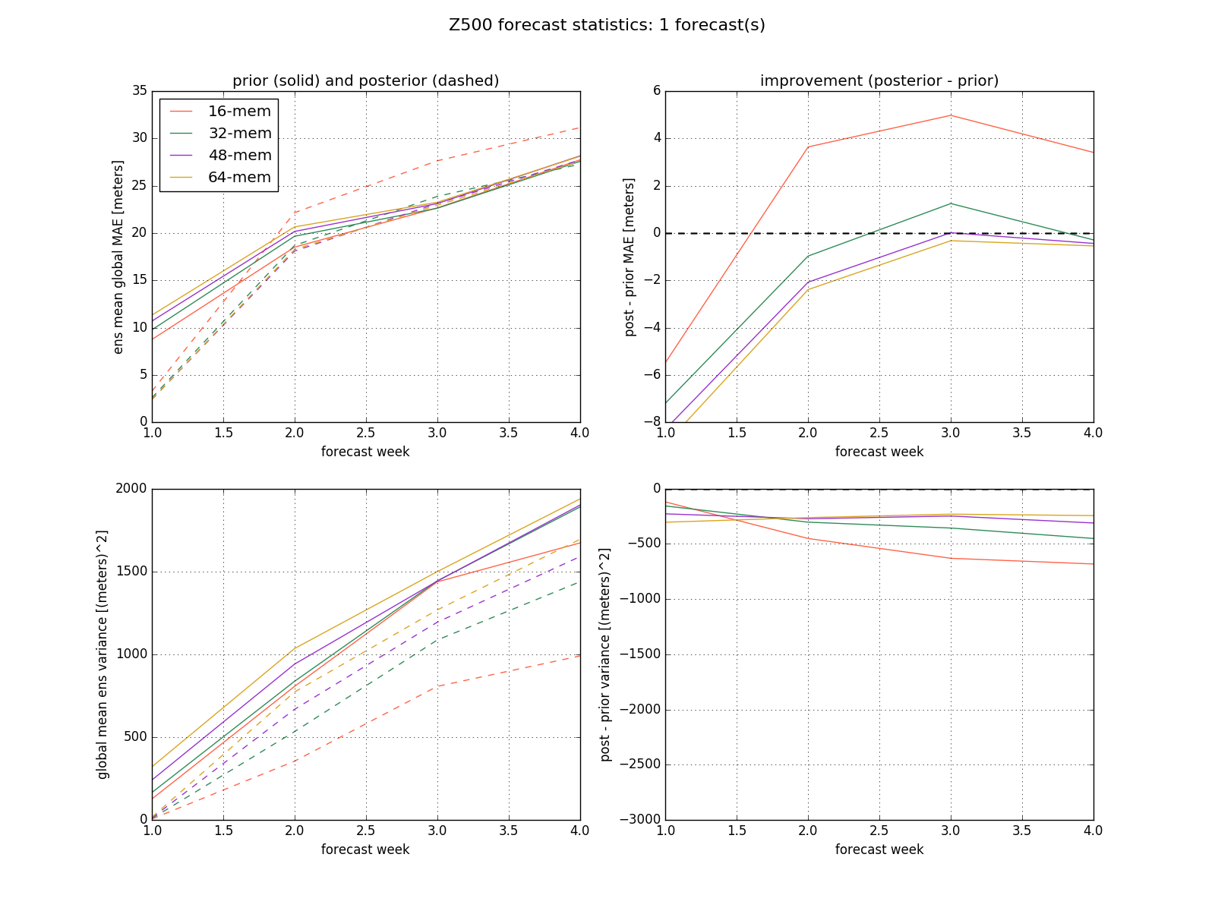
This year’s results: weekly averaged forecasts
“Obs” = sampling of week-1 CFSR
Standard GC-2000km localization: improvement through week 2
Localization is key for averaged forecasts, and we haven’t found one that works better than GC2000 yet...

Slide 29
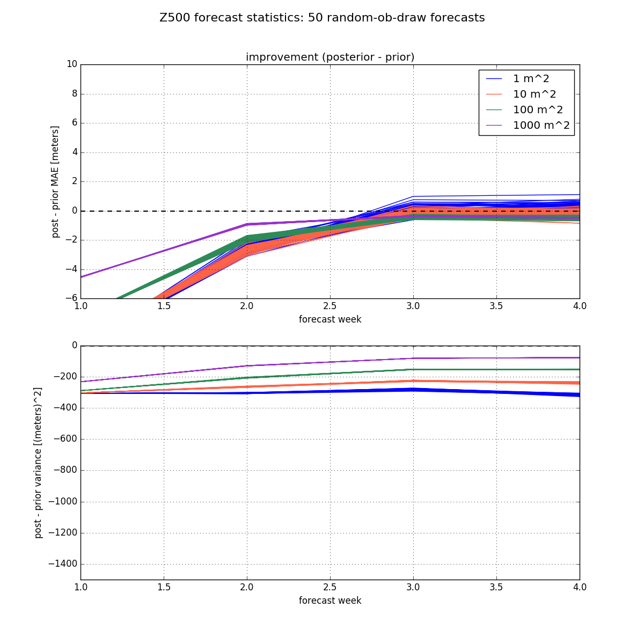
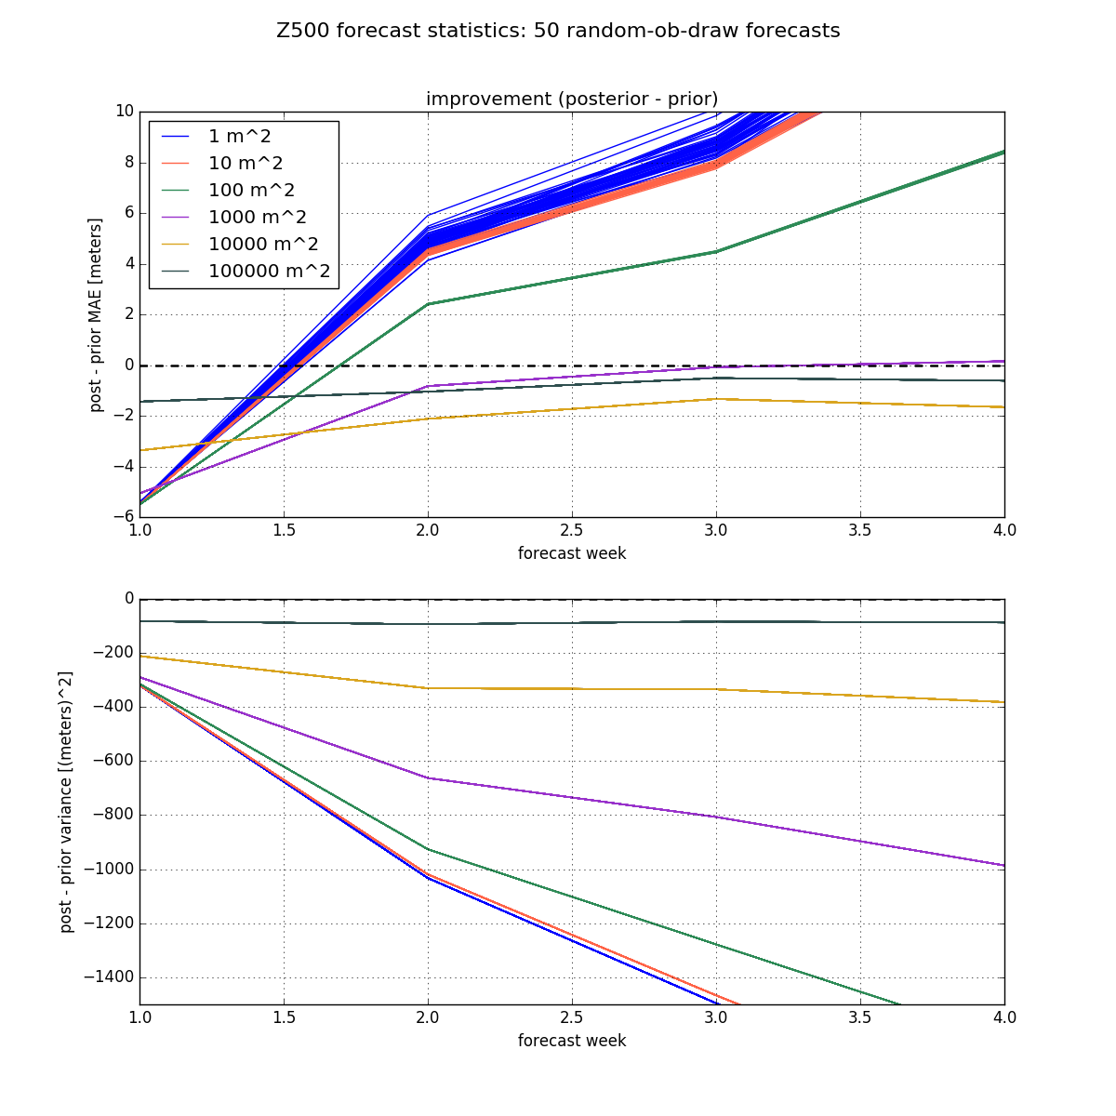
Weekly averaged forecasts
When localization is not used, the prescribed “ob” error variance significantly impacts the resulting skill improvement (less of an effect with localization)
GC2000 localization
no localization
* Monte-Carlo experiments

Slide 30
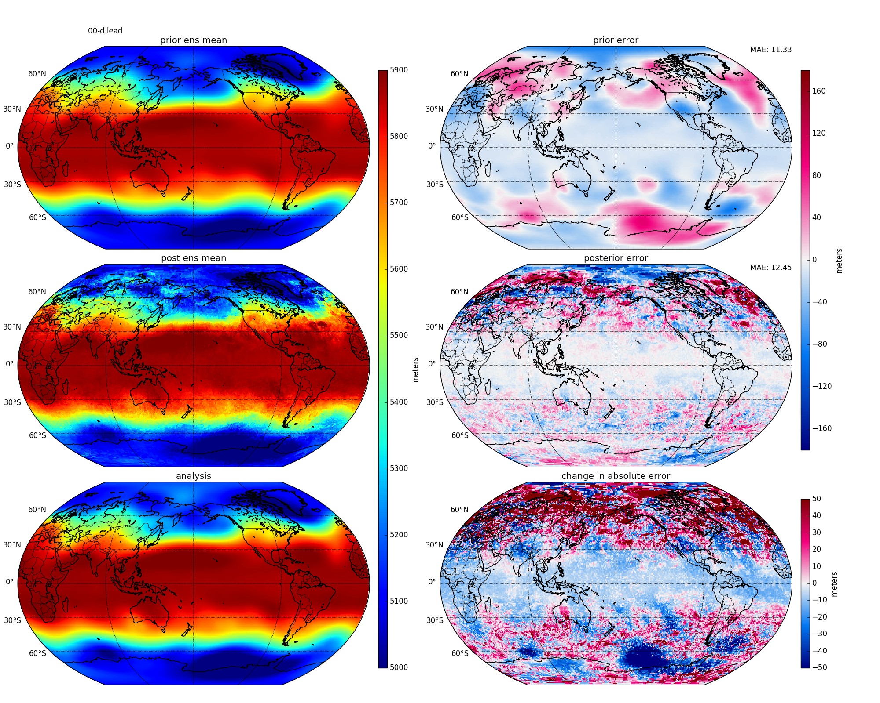
Weekly averaged forecasts
Significance-based localization is even worse than for un-averaged forecasts…

Slide 31
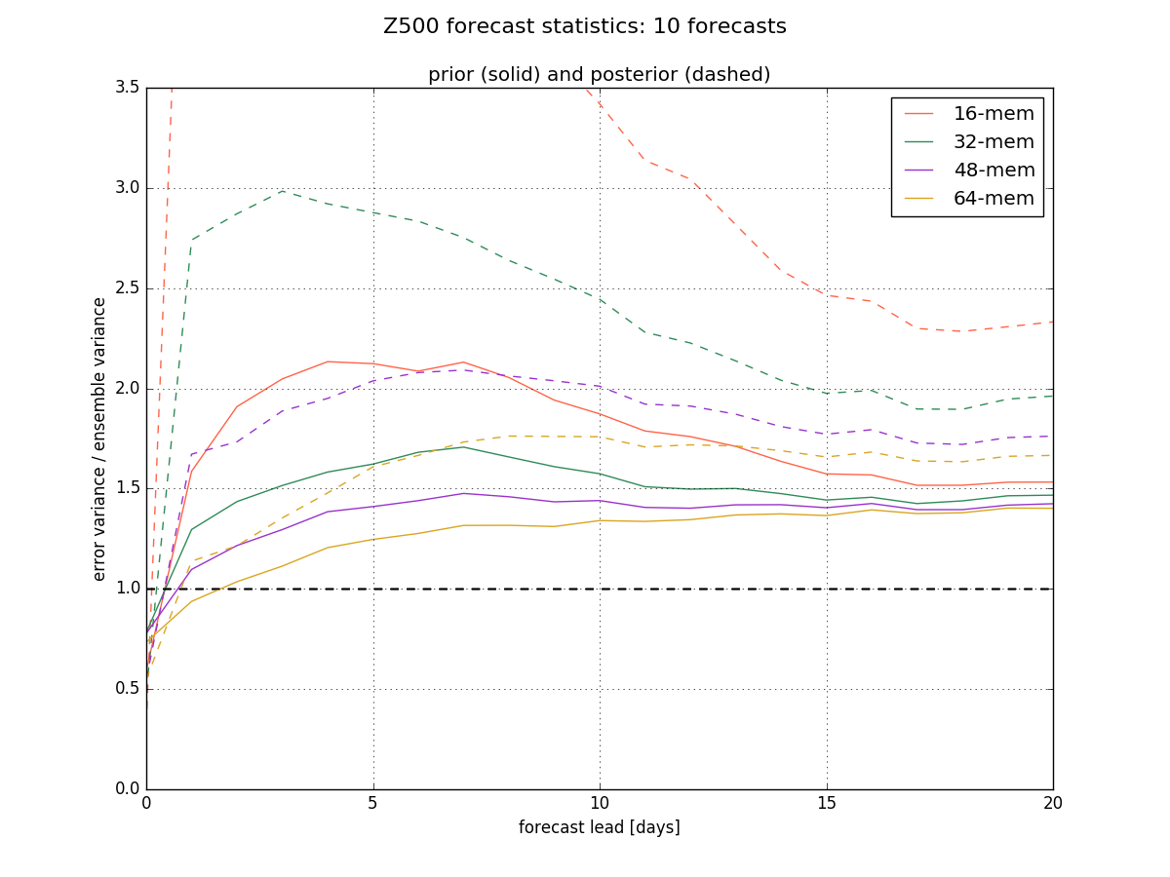
Other results: inflating the prior
Ensemble calibration ratio (error variance) / (ens variance) reveals an imperfectly calibrated prior
Posterior becomes more poorly calibrated

Slide 32
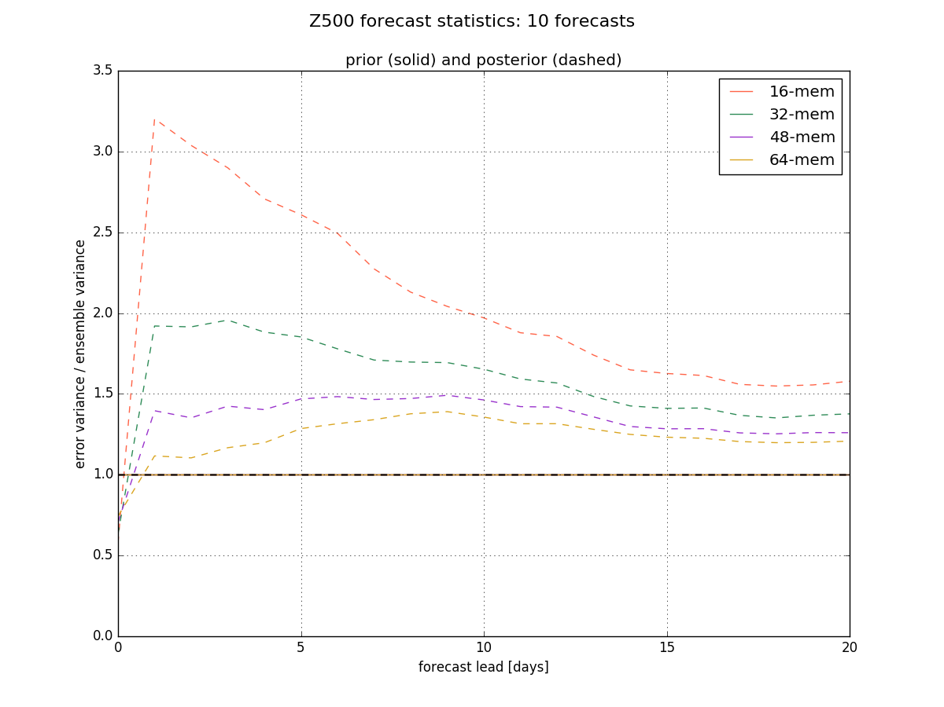
Inflating the prior
Calibration fixes the prior

Slide 33
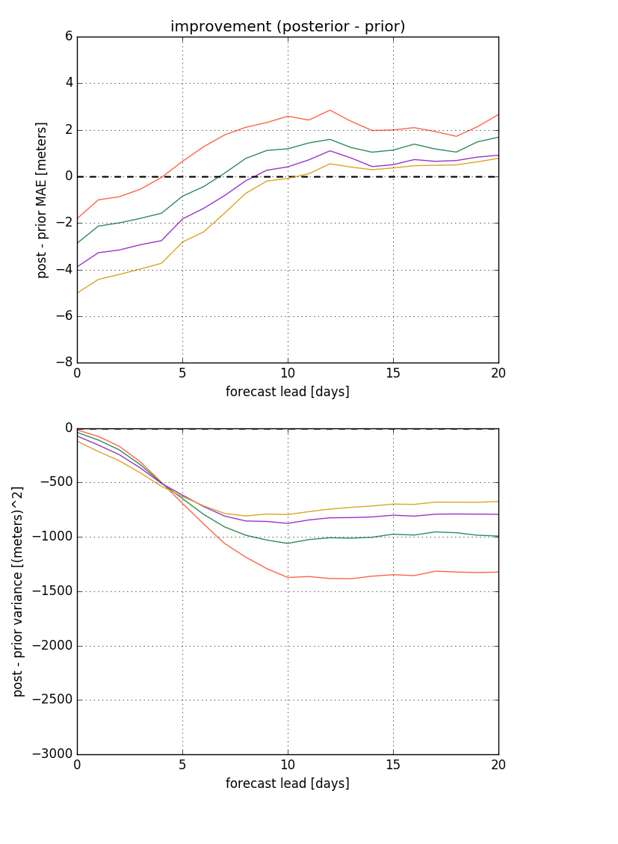
Inflating the prior
Calibration fixes the prior
However, the inflation slightly reduces the skill improvement…
Note: as seen on the previous slide, the variance at the initial time is actually reduced by this technique, which likely mitigates the benefit of inflation
To-Do: Ignore the initial time when doing inflation
Un-inflated prior
Inflated prior

Slide 34
Other possible experiments
Other “knobs” have little effect on or reduce skill improvement…
Changing the ob sampling density
Using the ensemble mean from only the most recent 16 members
Assimilating obs at multiple times

Slide 35
Conclusions

Slide 36
Hypotheses
CFS fails to produce propagating features because the CFS convective parameterization is unable to generate the realistic convection and convectively-coupled waves
Model biases, in particular, the wet bias in the West Pacific, may explain the slow MJO propagation and the “Marine Continent Barrier”
CFS subseasonal prediction and ability to get realistic midlatitude teleconnection is undermined by its inability to produce realistic convection and mesoscale convective propagation in the tropics.
Such problems could be improved by improved convective parameterization.
The real solution is probably explicit simulation of convection with global models having convective-allowing resolution in the tropics. This hypothesis should be tested.

Slide 37
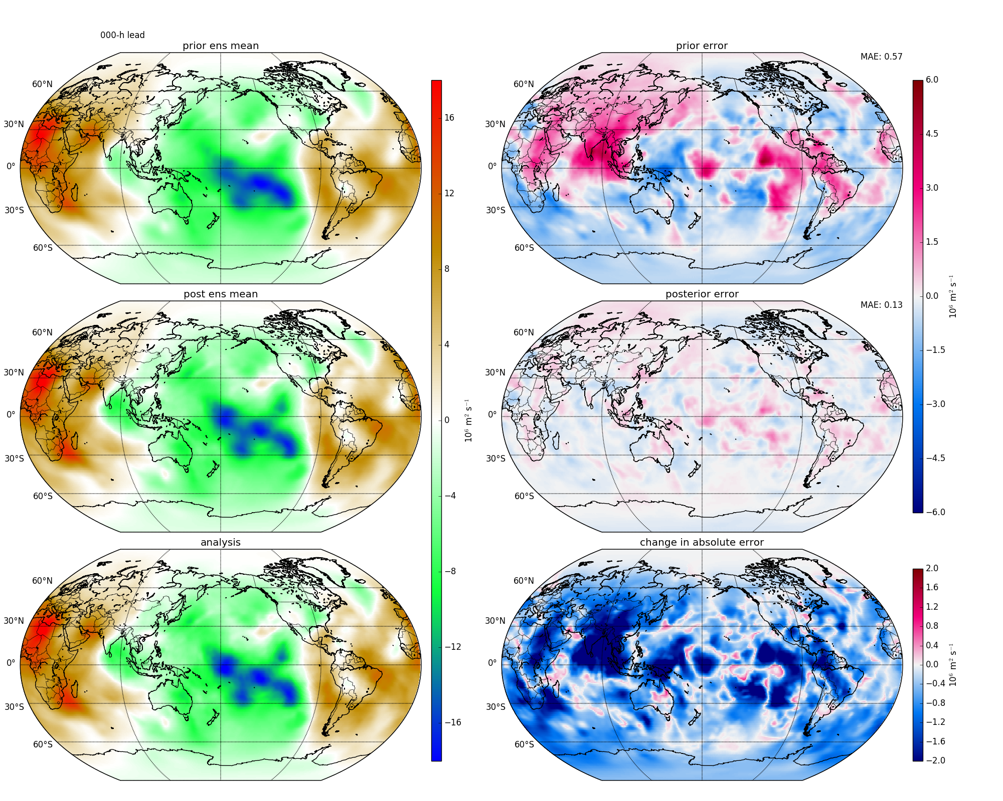
EFA: first experiment: Can we improve the F00 initial state from a lagged ensemble?
CHI200 F00 (days)
Prior
Prior - GDAS
Post
Post - GDAS
Improvement
(blue = error reduction)
GDAS

Slide 38
EFA: first experiment: Improve the initial state?
CHI200 F00 (days)
Prior
Post
Improvement virtually everywhere at initialization time!
GDAS

Slide 39
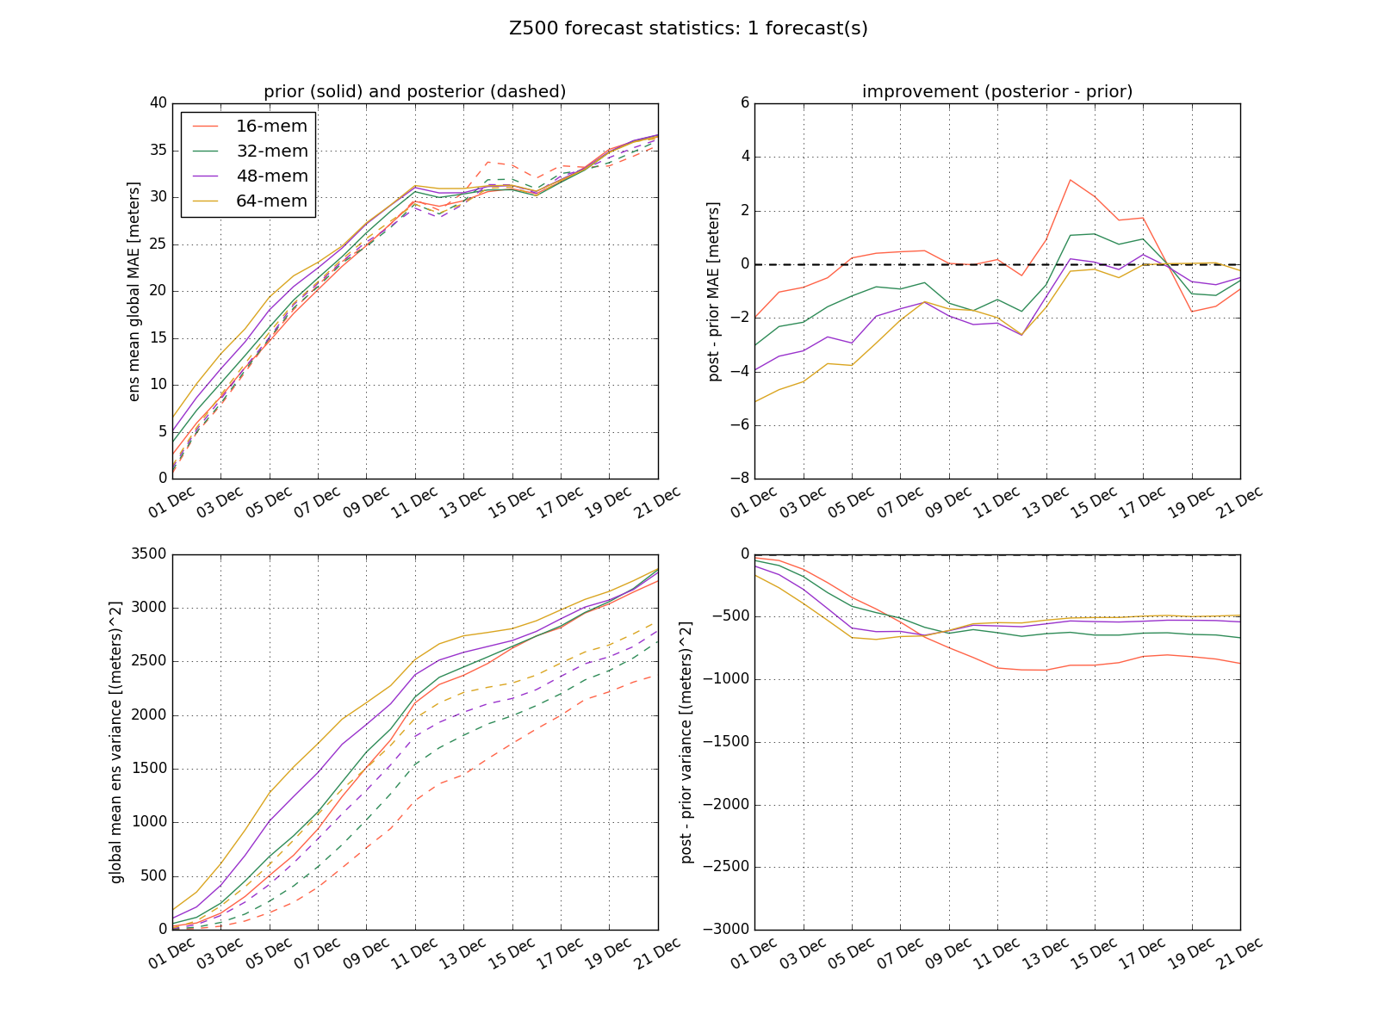
EFA first experiment: Global MAE at 500 hPa
Bottom line: We can improve a lagged ensemble.

Slide 40
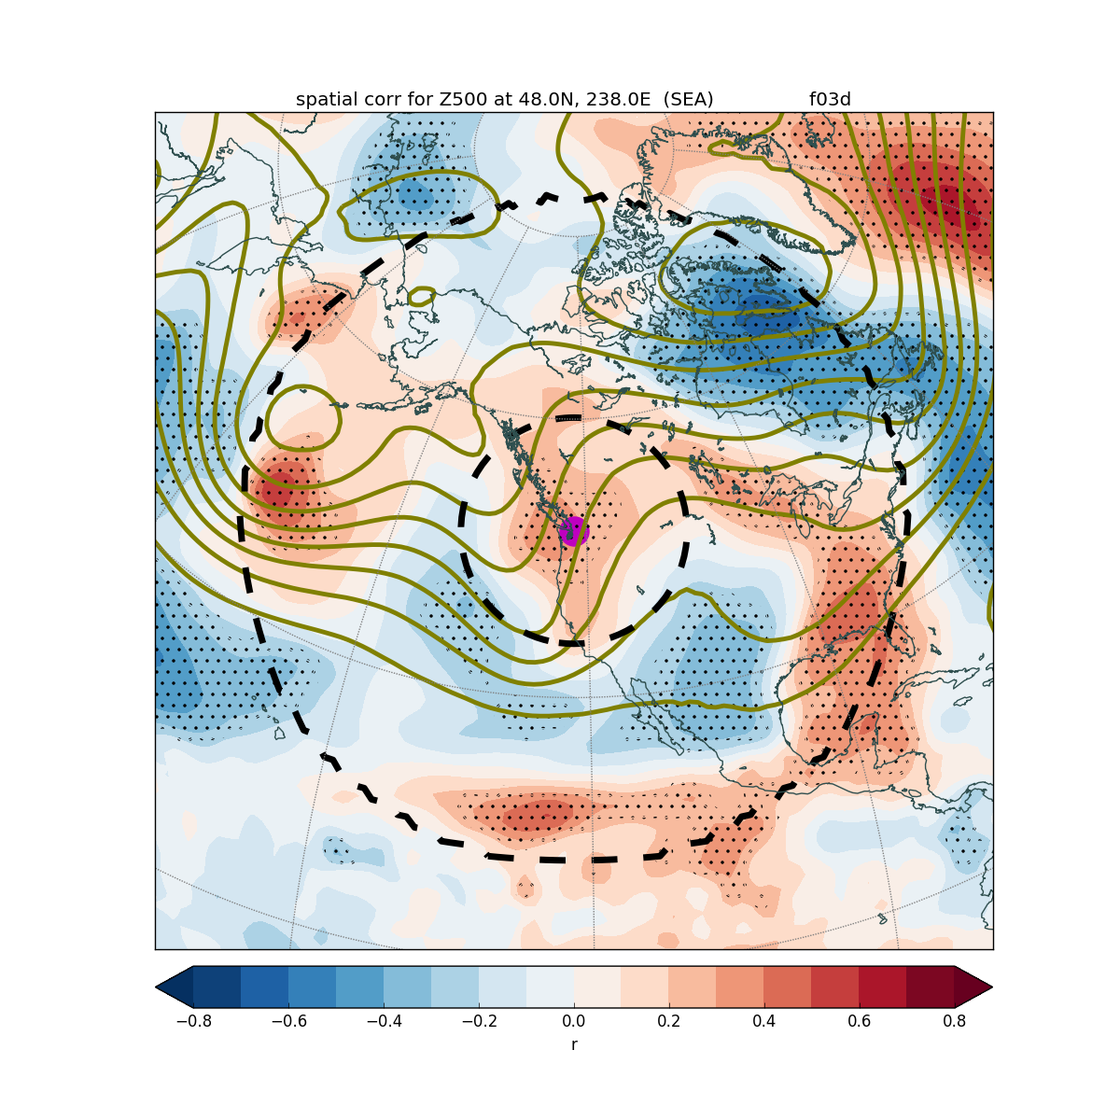
Next step: significance-based localization of our modifications
Spatial localization (e.g., Gaspari-Cohn) misses statistically significant covariances outside the localization radius

Slide 41
EFA: significance-based localization
Only update the points that are significantly correlated with the observation

Slide 42
EFA development and testing. Upcoming work:
Adjust prior ensemble inflation and observational error to optimize skill improvement
Do assimilation with observation localization based on statistical significance
Process all the forecasts for DJF ‘15-’16
Temporally average the forecasts prior to assimilation → averaged forecasts should have higher temporal covariances

Slide 43
If EFA works in enhancing subseasonal prediction, can go forward with with higher resolution downscaling over the western for weeks 3-4. If not, since it does appear to help with weeks 1-2, could use to drive downscaling for that period (particularly week 2) But since poor convective propagation is obviously a major issue, why not fix that in the best way possible?

Slide 44
What we would like to propose: the grand experiment for subseasonal forecasting
Run an extended global forecasting experiment with convection-allowing resolution (2-4 km) over the tropics.
1-2 month simulation
CRAY has offered the computer time.
Hypothesis: such a simulation will produce far better convection and propagation in tropics and will greatly enhance the fidelity of midlatitude teleconnections and thus subseasonal prediction.
Ready to do this now, with support of a grad student.

